Slide 1
Socratic Seminars

Slide 2
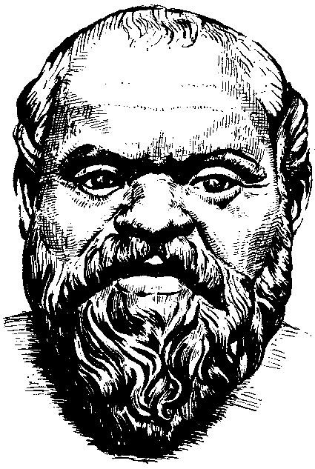
This is Socrates. What is he known for?

Slide 3
Socrates
Ancient Greek philosopher from Athens
Major influence on Western philosophy
From him we get the “Socratic Method”

Slide 4
What is the “Socratic Method?”
Philosophy = students think for themselves rather than being told what the “right” answer is
To do this, we want to engage in dialogue
What is dialogue? What is debate?
What is the difference between dialogue and debate?

Slide 5
What is a “Socratic Seminar”?
A conversation – we want to engage in meaningful discussion
Asking open-ended questions to engage in critical analysis and consider multiple interpretations
For a platform like a Socratic Seminar to work, what is necessary of the participants? That is, how must they treat one another? Should there be “ground rules”?

Slide 6
Something to Consider: Why would sitting in a circle when participating in a Socratic Seminar be helpful for meaningful discussion?

