Slide 1
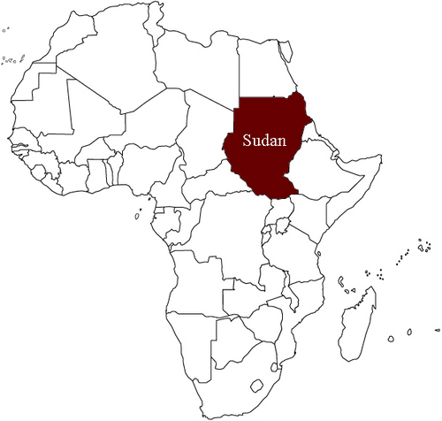
SUDAN: its location
http://www.faculty.fairfield.edu/faculty/hodgson/Courses/so191/Projects2007/Mannix/part1.html

Slide 2
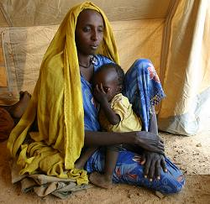
SUDAN: its people
http://gbgm-umc.org/

Slide 3
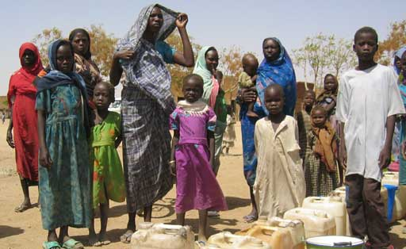
http://www.faculty.fairfield.edu/faculty/hodgson/Courses/so191/Projects2007/Mannix/ColleenFinal.html

Slide 4
Sudanese Song http://www.youtube.com/watch?v=NZZtSTXz1PE&feature=related

Slide 5
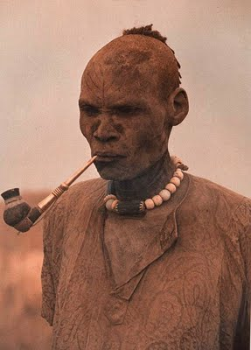
The Dinka of Sudan
http://saharanvibe.blogspot.com/2007/03/dinka-of-sudan.html

Slide 6
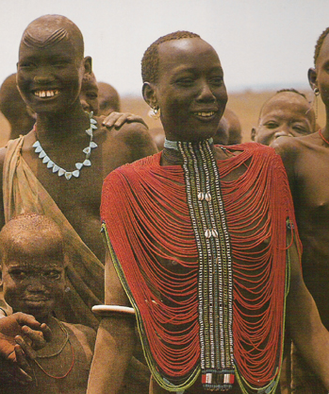
The Dinka, who call themselves the Moinjaang, are the largest ethnic group in southern Sudan.
http://saharanvibe.blogspot.com/2007/03/dinka-of-sudan.html

Slide 7
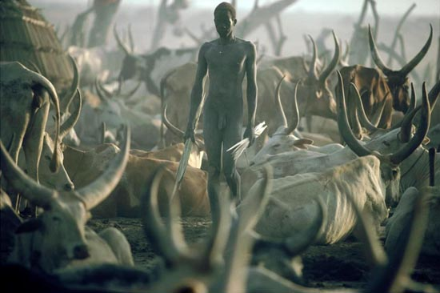
Dinka lifestyle centers around their cattle.

Slide 8
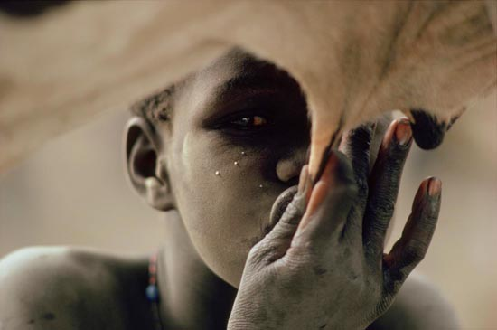
“Initiation marks a young man’s passage to adulthood. An initiate is called a ‘parapuol’ – one who has stopped milking.” http://saharanvibe.blogspot.com/2007/03/dinka-of-sudan.html

Slide 9
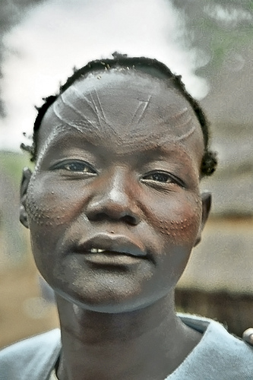
Parapuol
This Dinka man has been “scarified,” during a ritual that takes place between the ages of 10 and 16. His scars identify him as a member of a particular Dinka tribe. After initiation, a parapuol is given an oxen (cattle), his most precious possession.
http://saharanvibe.blogspot.com/2007/03/dinka-of-sudan.html

Slide 10
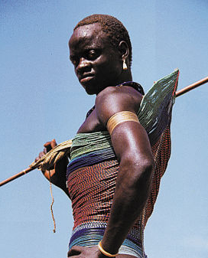
“Corseted Dinka Man. Besides cattle, the most coveted possession of a Dinka man is an intricately beaded corset. This corset is sewn on tightly and worn until marriage.”
http://saharanvibe.blogspot.com/2007/03/dinka-of-sudan.html

Slide 11
Sounds of Global Worship: Heart Sounds International http://www.youtube.com/watch?v=W3oYUDfjC3s

Slide 12
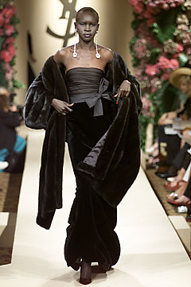
Dinka Supermodel: Alec Wek
http://saharanvibe.blogspot.com/2007/03/dinka-of-sudan.html

